Slide 1
YOLOv3: An Incremental Improvement final report for exam project (repository link)
Faculty of Computer Science
Data Science
Moscow 2022
Written by:
Joseph Redmon Ali Farhadi.
Presented by:
Anwar Ibrahim Fares Ghazzawi.

Slide 2
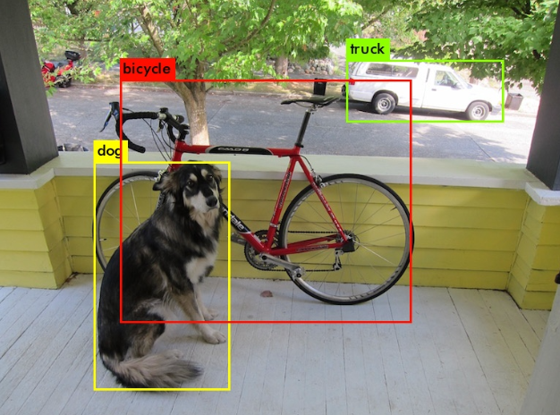
Introduction
Our task for exam project is to reimplement the model from the paper ‘YOLOv3: An Incremental Improvement’, train it on a dataset (PASCAL_VOC).
In this presentation will:
introduce the Yolo model.
Explain the unique approaches that made this model standout.
Recap our approach to implement this model.
We will show our results.

Slide 3
Introducing Yolo
Yolo is one of the most famous real-time object detection.
Was first introduced in 2016.
Since then we had several versions the last one was introduced in November 2022.
Yolo models are fast they can process video feeds at a high frames-per-second rate.
They continue to lead the way in terms of accuracy, yolov7 has state of the art performance when measured against MS COCO.
Yolo models are open source.

Slide 4
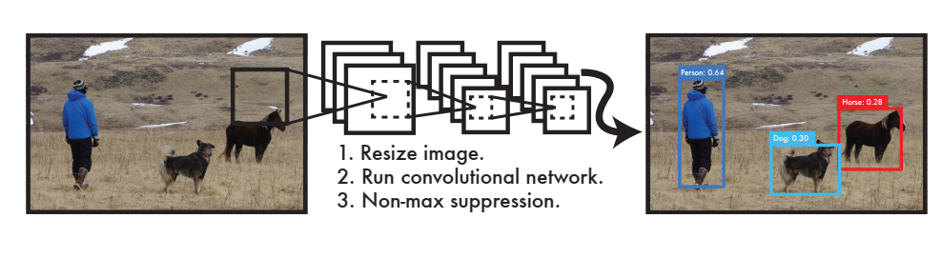
Start from the beginning
The previously used systems takes a classifier for an object and evaluates it at various locations and scales “sliding window approach, and regional proposed methods”
This pipelines are slow and hard to optimize.
with Yolo “You Only Look Once” at the row image to predict the objects and where they are, all with a single neural network.
Notes:
We know that transformers were born a solution to RNNs, wasteful at training time, and they do sequential processing

Slide 5
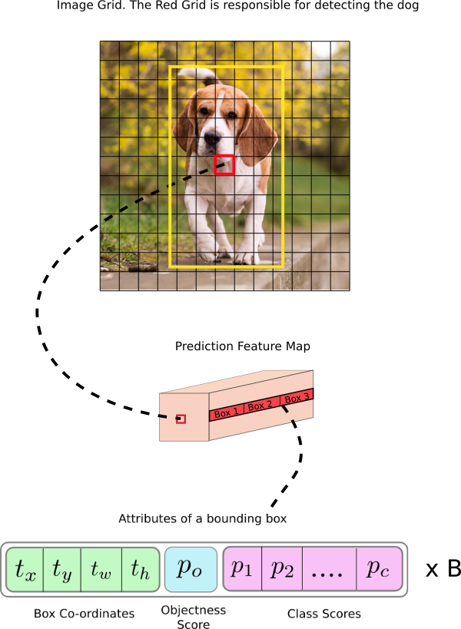
The approach
The system divides the image into SxS grid.
if the center of an object falls into a grid’s cell, then this cell is responsible for detecting this object.
Each cell predicts B bounding boxes and confidence score to show how confident our model is that the box contains an object.
Each outputted bonding box contains 6 components: x, y, w, h and the confidence, and a conditional Class probability.
Notes:
We know that transformers were born a solution to RNNs, wasteful at training time, and they do sequential processing

Slide 6
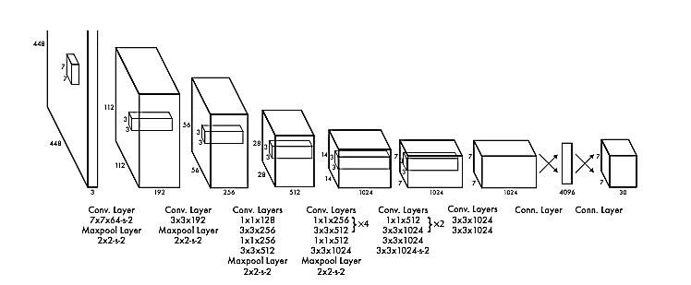
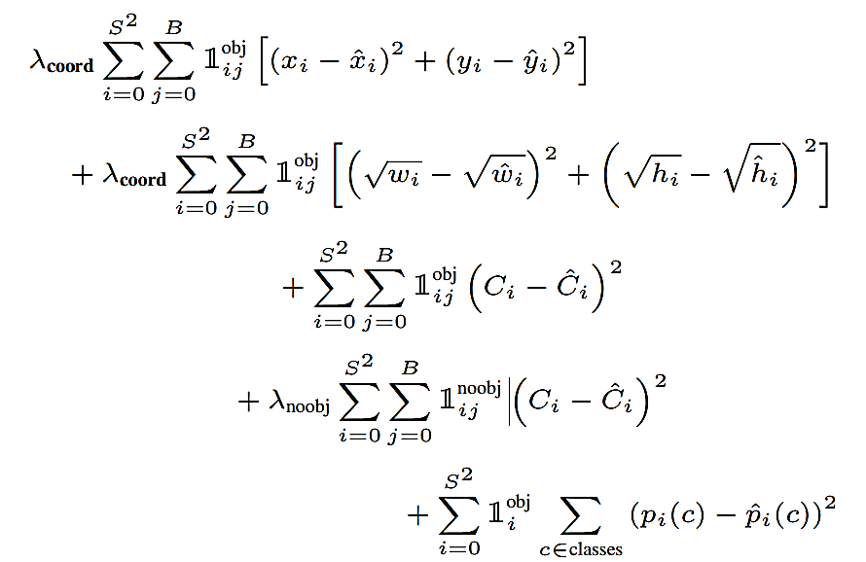
YoloV1 architecture & Loss function

Slide 7
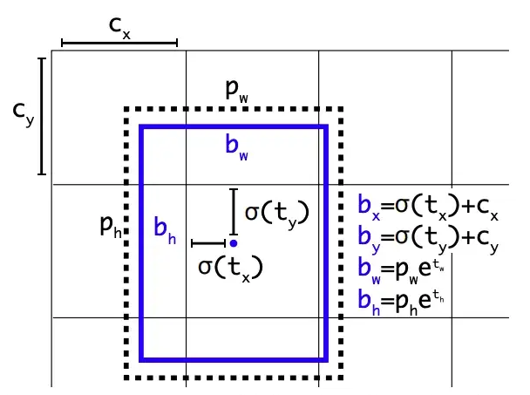
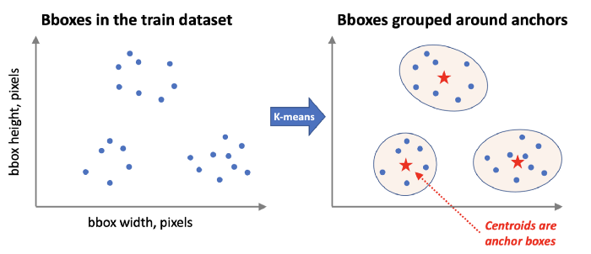
Anchor boxes
They similar to a constant that you pass to the model, and this is defined before starting to train the network.
A set of predefined bounding boxes of a certain height and width.
Used to capture the scale and aspect ration of a specific object classes that we want to detect.
Chosen based on object sizes in the training dataset, we can choose anchor boxes using k-means algorithm.
Yolo predicts bounding boxes as displacements from anchor boxes.

Slide 8
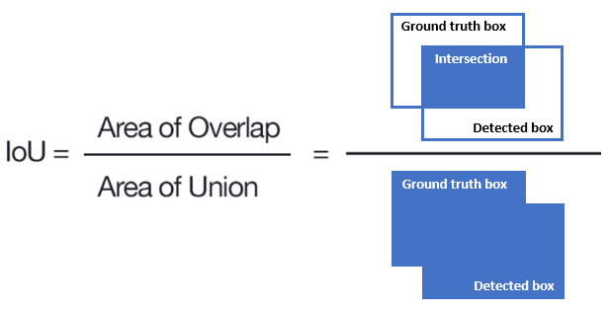
Intersection Over Union
IOU : is a metric that measures how similar a predicted bounding box is to the original bounding box.
We will use this metric several times in our code:
Notes:
We know that transformers were born a solution to RNNs, wasteful at training time, and they do sequential processing

Slide 9
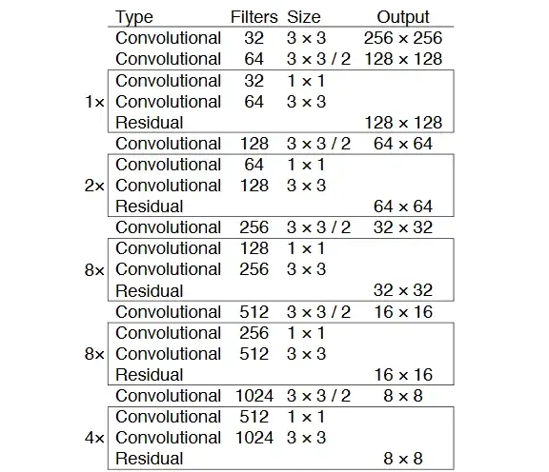
YoloV3 Architecture
The model consists of two different parts: First, Feature extraction: using a DARKNET53. Second, Bounding boxes prediction (also 53 Conv Layers with Residuals).
Since the paper falls short in describing the Second part of the model (first part in the shown figure) , we have used the Config file (and other online resources mentioned in the code) of the original author to understand the structure of the model.
Notes:
We know that transformers were born a solution to RNNs, wasteful at training time, and they do sequential processing

Slide 10
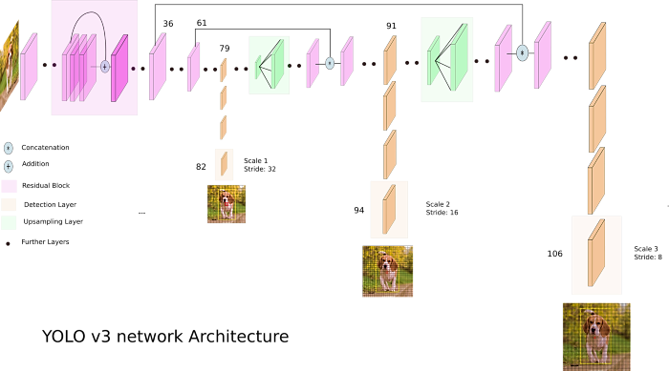
YOLOv3 architecture
Notes:
The encoder creates a contextualized representation for each input token using self-attention. And it adds information to this token from the other tokens.
Representations are dependent on all the input, not just one direction.
Self attention is the heart of the Transformer, and the beauty of self-attention is its simplicity it has only matrix multiplication, linear projection, and a SoftMax operation.

Slide 11
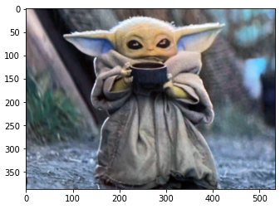
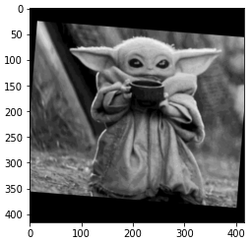
Preprocessing
We used Pytorch framework to implement our code.
To train the model we used “The PASCAL Visual Object Classes” dataset.
To improve the training process we performed some data augmentation steps to convert the image as the following figure.

Slide 12
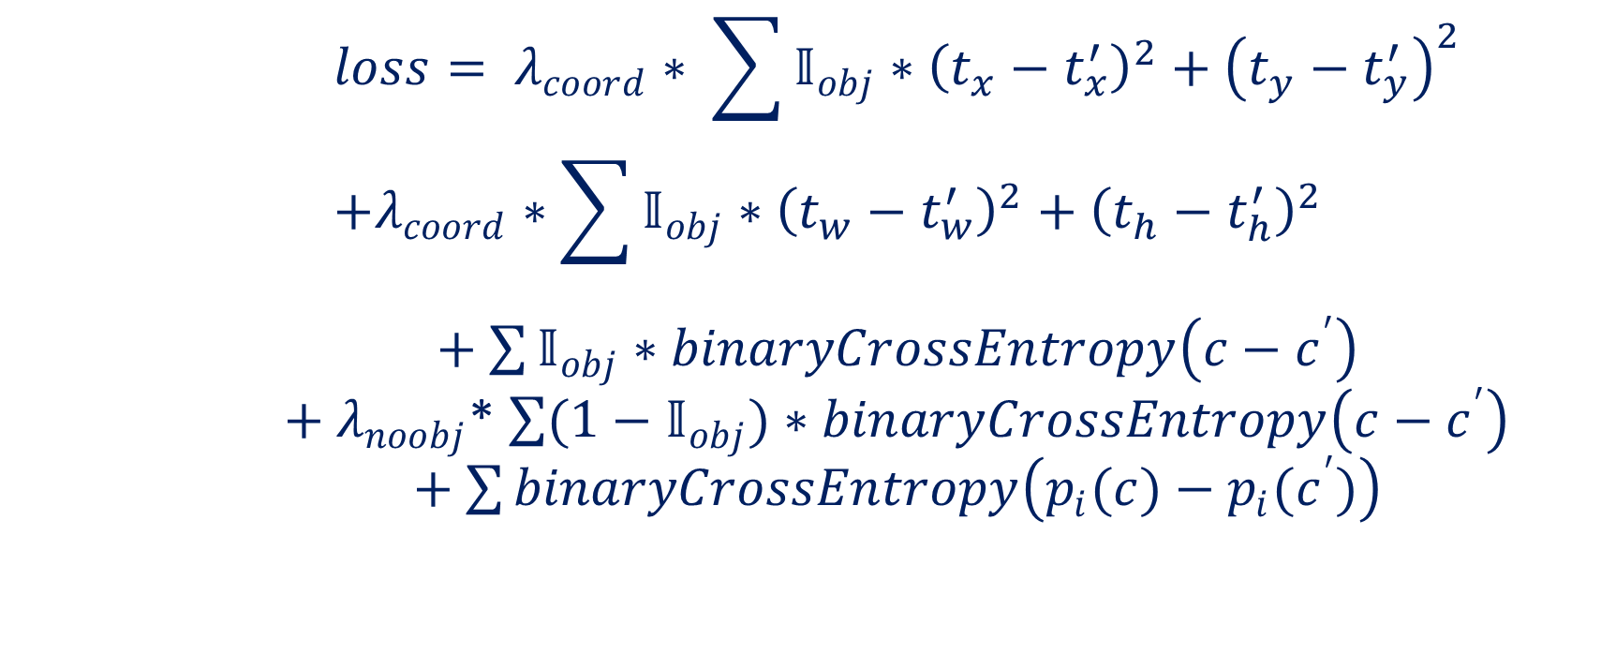
Loss function YoloV3
$$loss= λ_{coord}∗ \sum{𝕀_{obj}∗{\left(t_{x}−t_{x}^{′}\right)}^{2}+{\left(t_{y}−t_{y}^{′}\right)}^{2}} \\ +λ_{coord}∗\sum{𝕀_{obj}∗{\left(t_{w}−t_{w}^{′}\right)}^{2}+{\left(t_{h}−t_{h}^{′}\right)}^{2}}$$ $+$ $\sum{𝕀_{obj}∗binaryCrossEntropy\left(c−c^{′}\right)}$ $+$ $λ_{noobj}$* $\sum{{(1−𝕀}_{obj})∗binaryCrossEntropy\left(c−c^{′}\right)}$ $+$ $\sum{binaryCrossEntropy\left(p_{i}(c)−{p_{i}(c}^{′})\right)}$

Slide 13
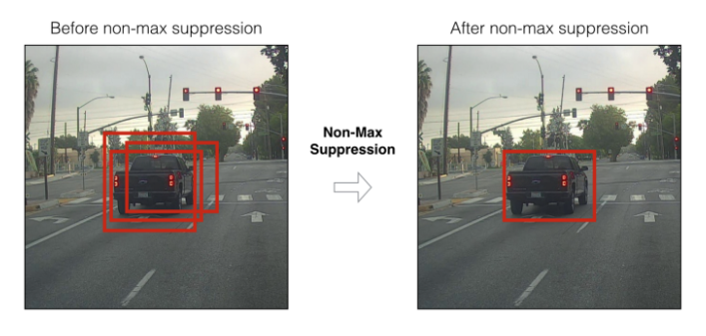
Non Max Suppression
One of the post processing steps.
Yolov3 multiple bounding boxes for the same object, we need to eliminate the duplicated results.
Researchers introduces Non-maximum-Suppression.
The idea behind:
Find out the detection box with the best confidence first, add it to the final result, and then eliminates all other boxes which have IOU over a certain threshold with this best box, do the same thing over and over until nothing is left.
Notes:
We know that transformers were born a solution to RNNs, wasteful at training time, and they do sequential processing

Slide 14
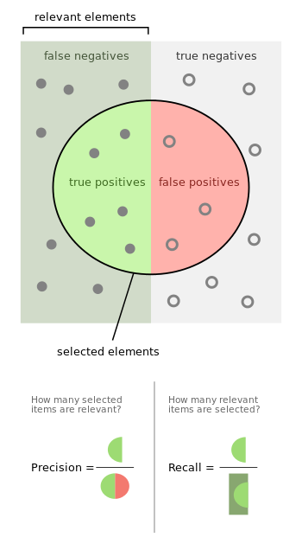
Mean average precision
We used mean average precision to evaluate our model.
the steps:
get all bounding box predictions on our test set.
sort the descending confidence scores.
calculate the precision and recall as we go through all outputs.
plot a graph of the precision in relation to the recall.
calculate the Area under the previous graph.
this process should be done for all classes.

Slide 15
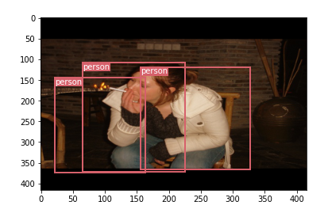
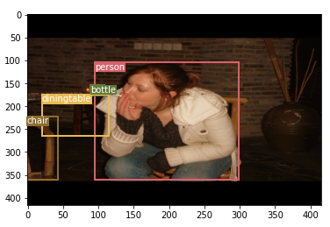
Results
When training for 10 epochs:
When training for 100 epochs:

Slide 16
Thanks for your attention
Let’s check some interesting parts of our code.

